Slide 1
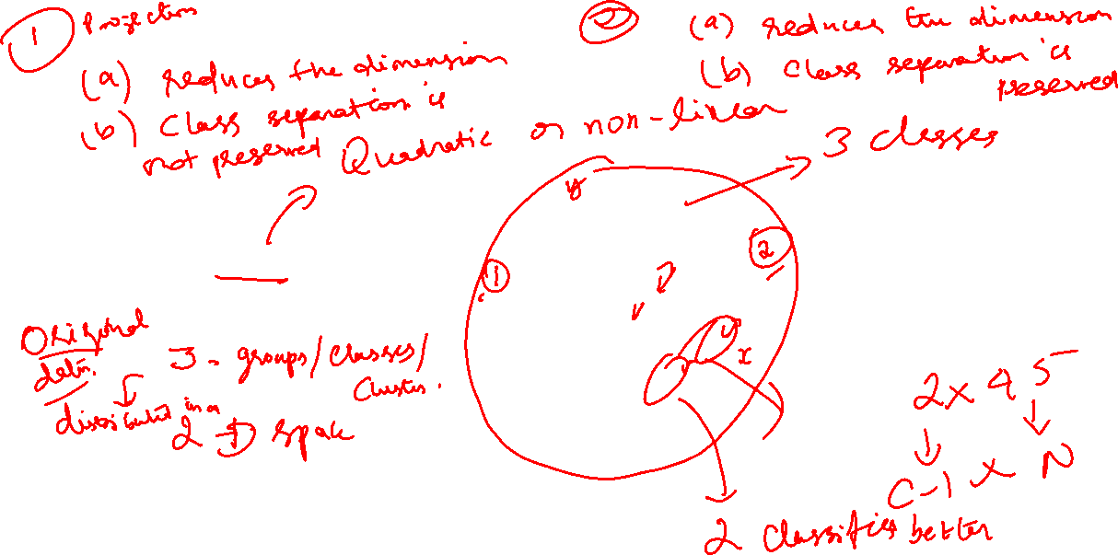

Slide 2


LDA Objective
The objective
of LDA is to perform
dimensionality reduction …
However, we want to preserve as much of the class discriminatory information as possible.
– OK, that’s new, let dwell deeper ☺ …

Slide 3
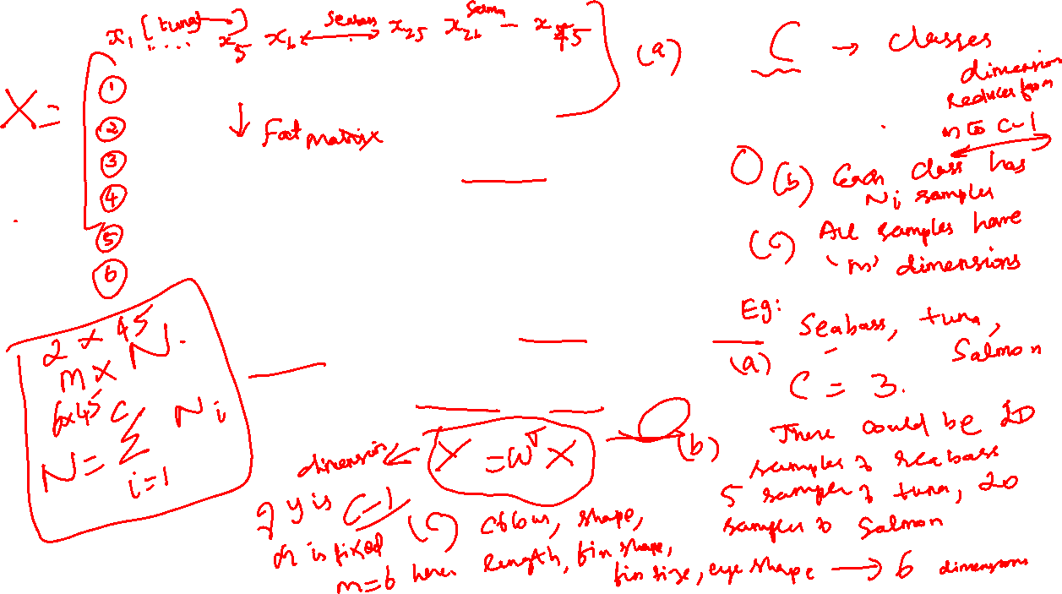
Now … LDA
Consider a pattern classification problem, where we have C classes, e.g. seabass, tuna, salmon …
Each class has N_{i} m-dimensional samples, where i = 1,2, …, C.
Hence we have a set of m-dimensional samples {x¹, x²,…, x^{Ni}} belong to class ω_{i}.
Stacking these samples from different classes into one big fat matrix X such that each column represents one sample.
We seek to obtain a transformation of X to Y through projecting the samples in X onto a hyperplane with dimension C-1 (reduce the dimension by 1)
Let’s see what does this mean?

Slide 4
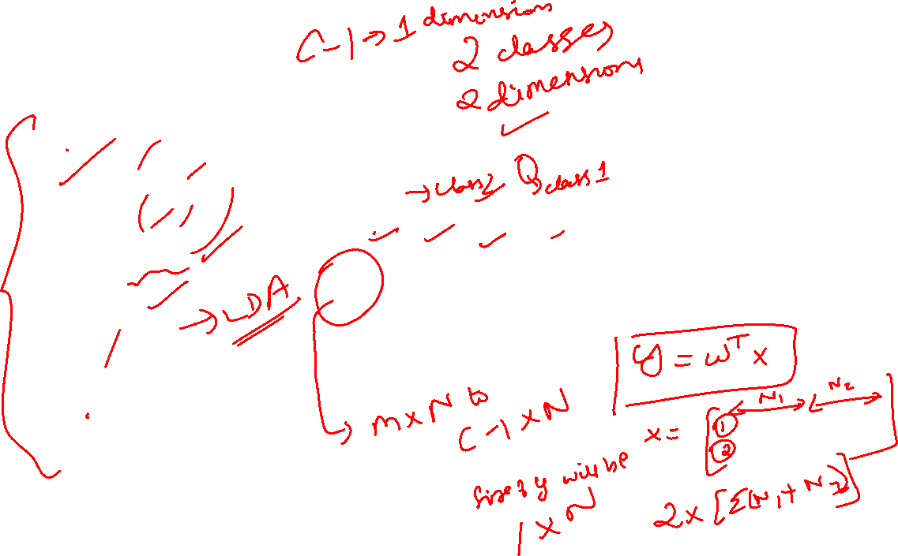
In the figure, there are two dimensions x₁ and x₂ with each of them having N₁ and N₂ data points from two different classes

Slide 5
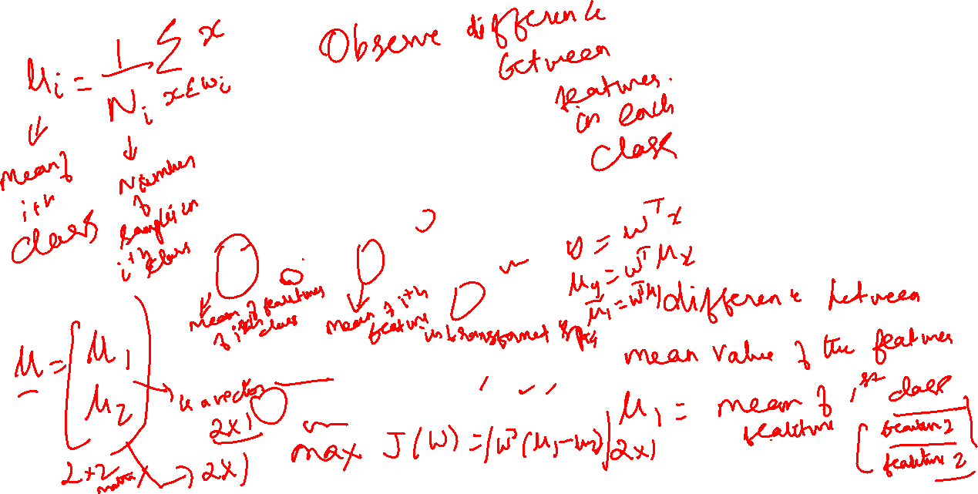

Slide 6
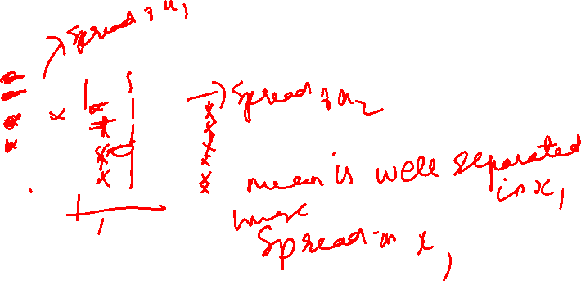

Slide 7
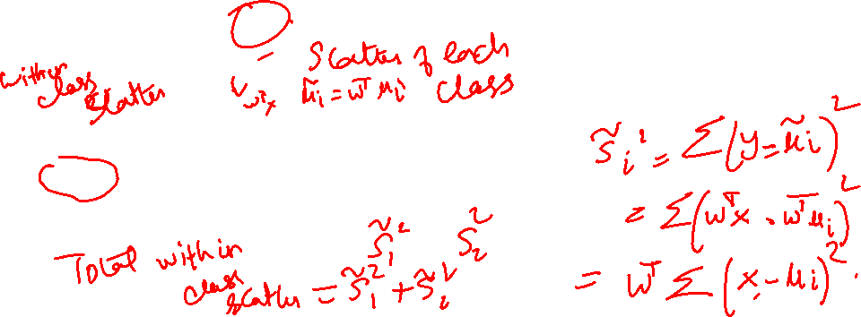

Slide 8
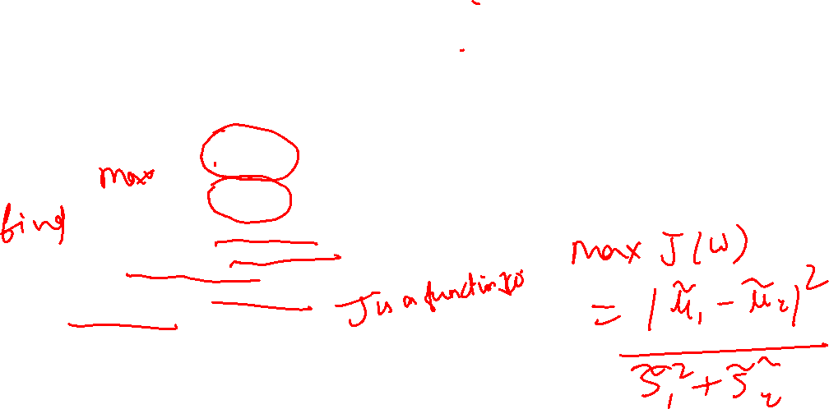

Slide 9
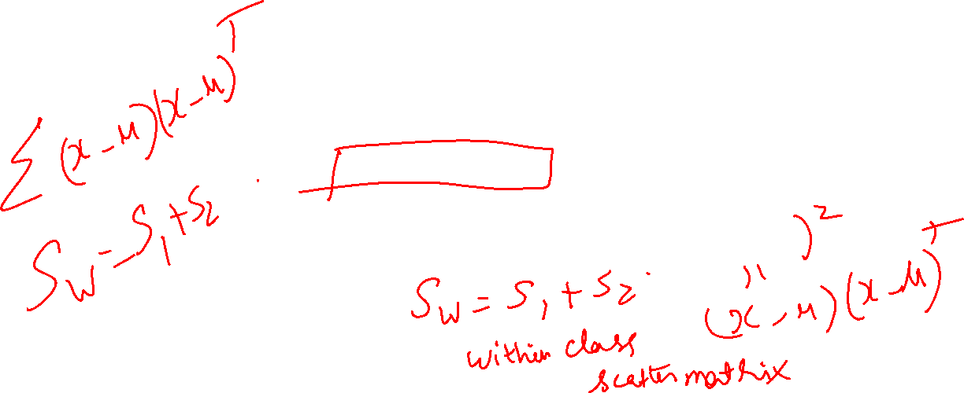


Slide 10
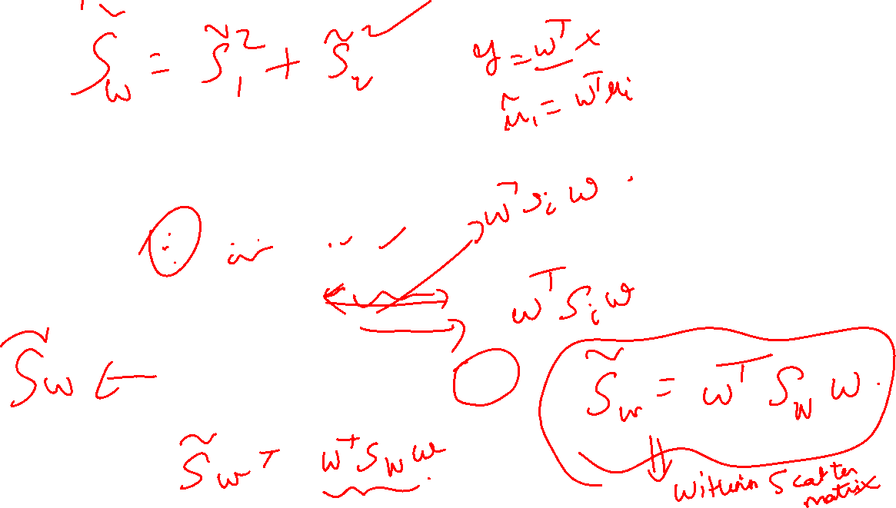

Slide 11
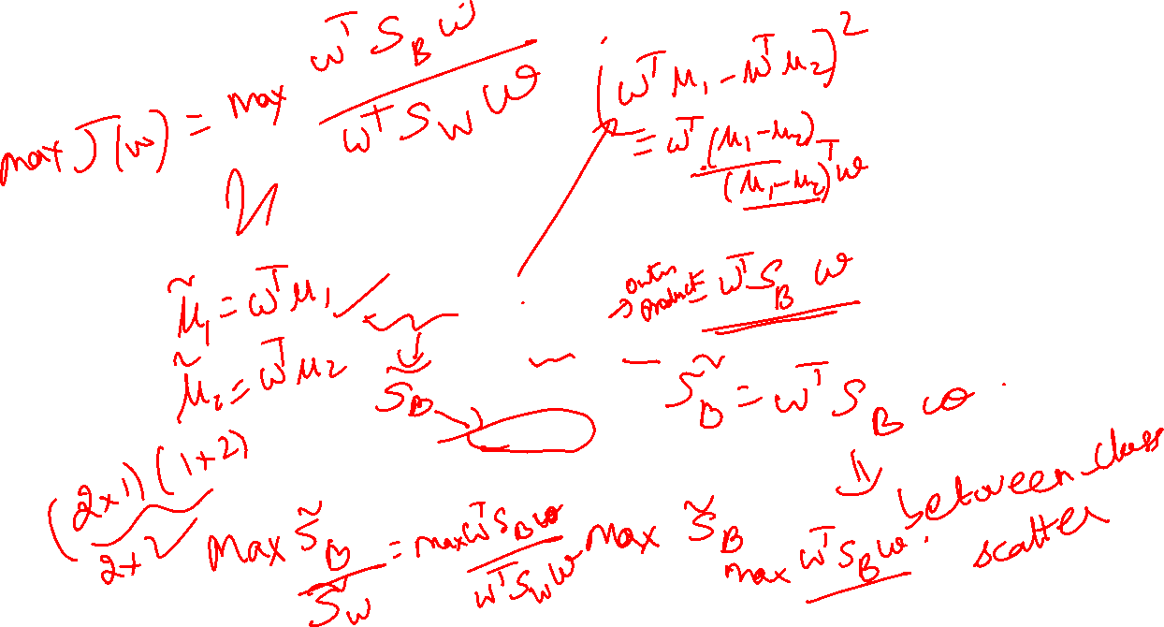

Slide 12
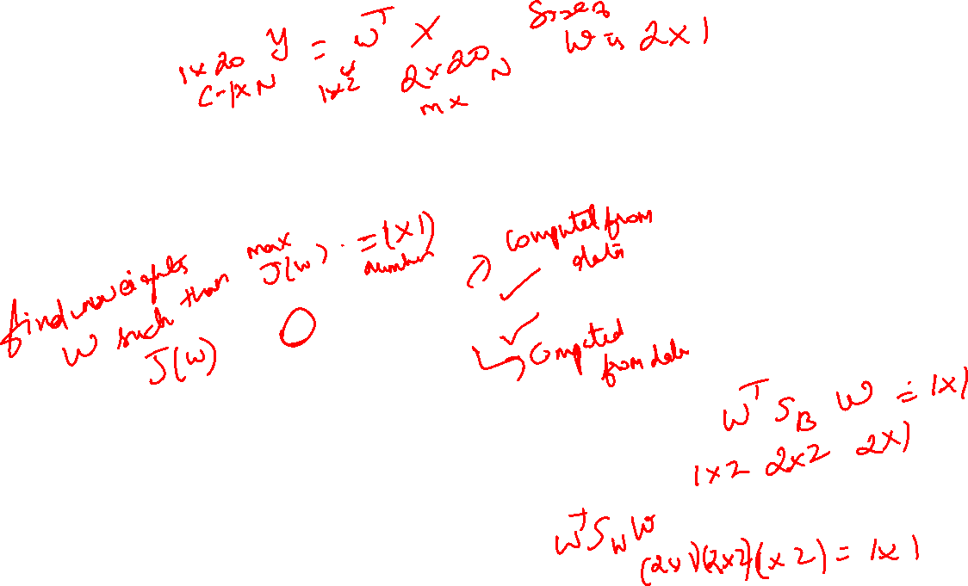


Slide 13
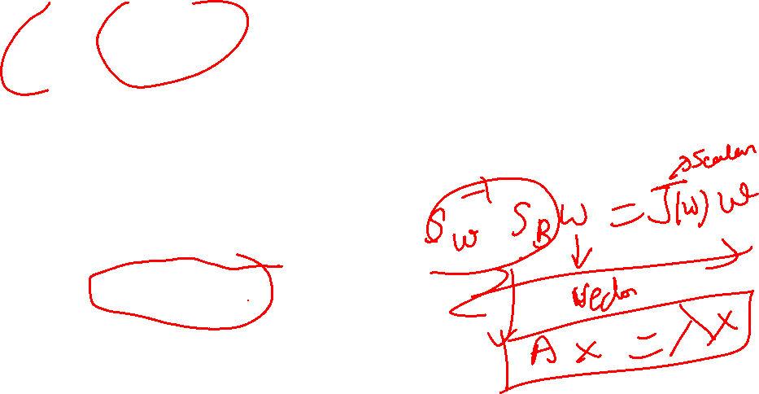

Slide 14
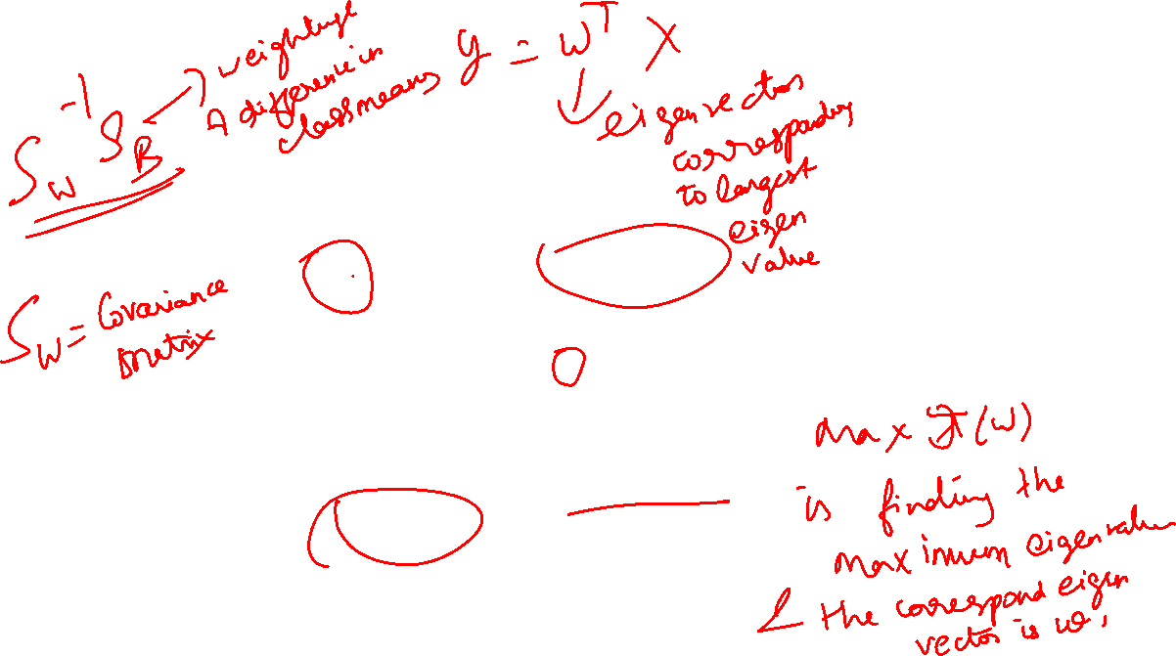

Slide 15
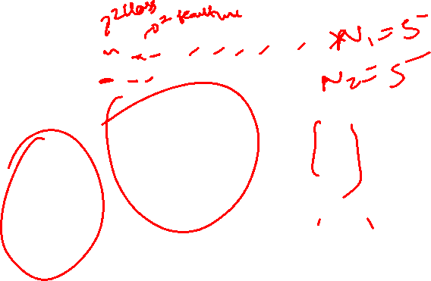

Slide 16

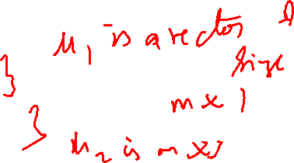

Slide 18

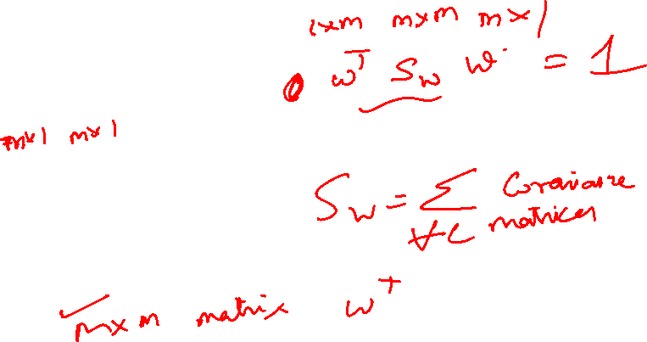

Slide 19


Slide 20


Slide 21
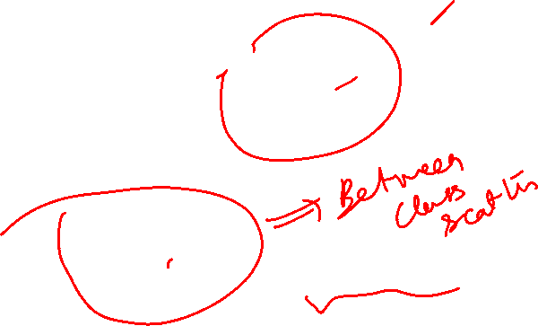

Slide 22


Slide 23
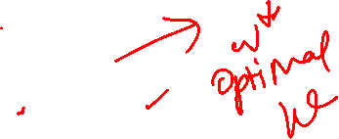

Slide 24
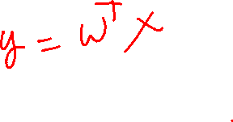

Slide 25
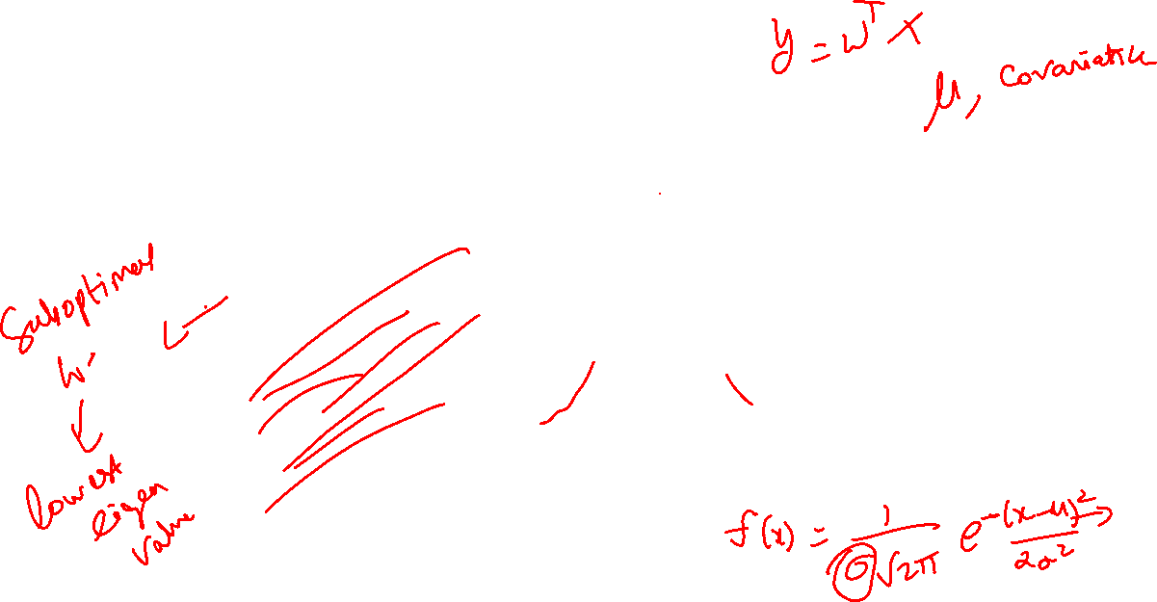
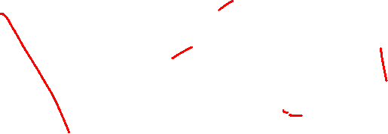

Slide 26
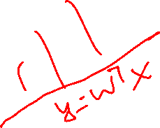


Slide 27
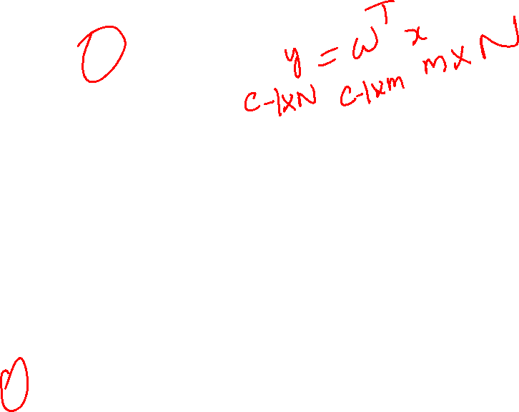
Here we are seeking c-1 projections (one less than the total number of classes)

Slide 28

In the equation, the size of the matrices are given below the variables X, Y and W

Slide 30



Slide 31


Slide 32
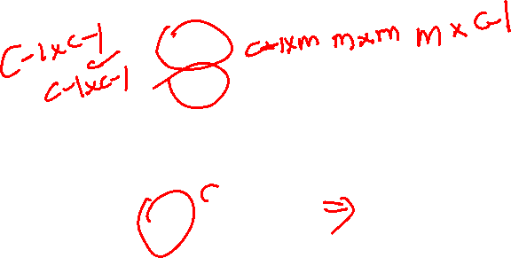

Slide 34

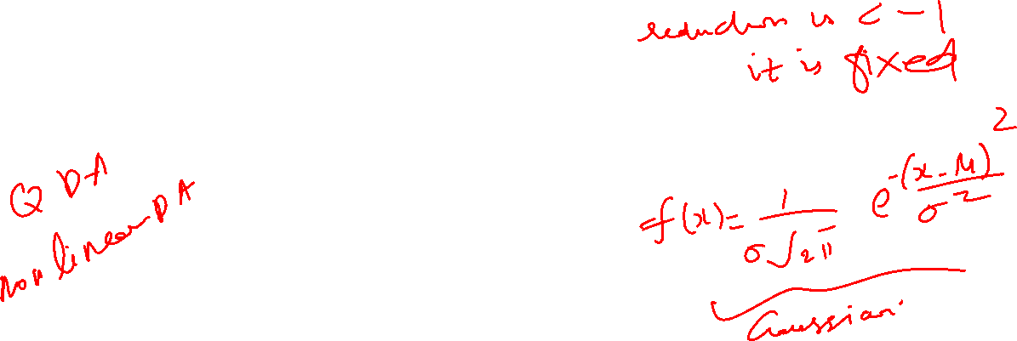

Slide 36
THANK YOU
Questions?

